Slide 1

Automata Theory (ITC404)
VES INSTITUTE OF TECHNOLOGY
DEPARTMENT OF INFORMATION TECHNOLOGY
BY
Mrs Charusheela Nehete
Assistant Professor,
IT Department ,
VESIT

Slide 2
Contents
Regular Expressions
Finite Automata
Kleene’s Theorem
RE to NFA - ε conversion
NFA – ε to DFA Conversion
NFA – ε to NFA without ε- moves Conversion

Slide 3
Introduction
Regular expressions and finite automata have equivalent expressive power:
For every regular expression R, there is a corresponding FA that accepts the set of strings generated by R.
For every FA A there is a corresponding regular expression that generates the set of strings accepted by A.

Slide 4
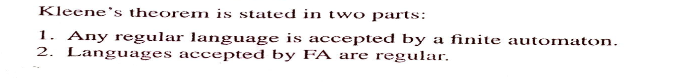
Kleene’s Theorem

Slide 5
RE to DFA conversion

Slide 6
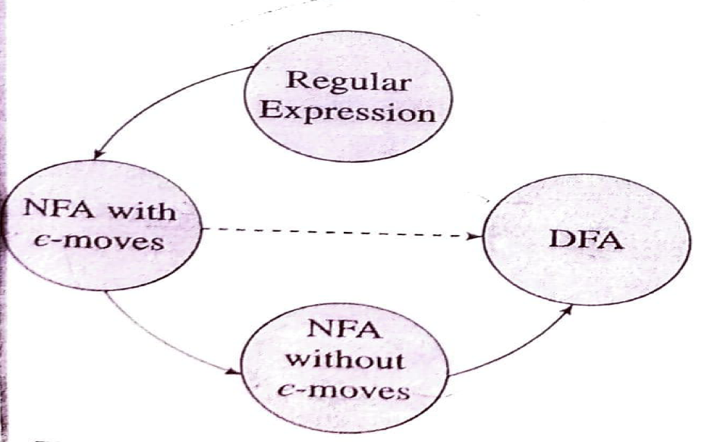
RE to FA conversion
3 steps
Construct NFA with epsilon transition
Convert it to NFA without epsilon transition
Construct equivalent DFA.

Slide 7
RE to NFA - ε moves

Slide 8
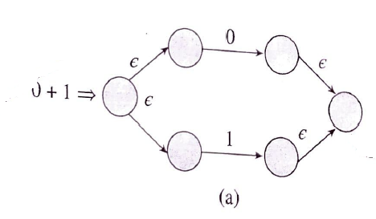
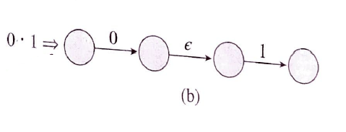
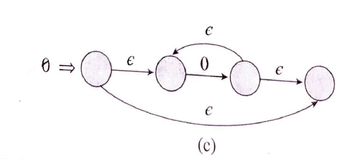
RE to NFA - ε moves
*

Slide 9
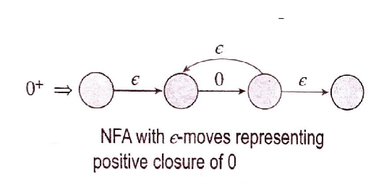
RE to NFA - ε moves

Slide 10
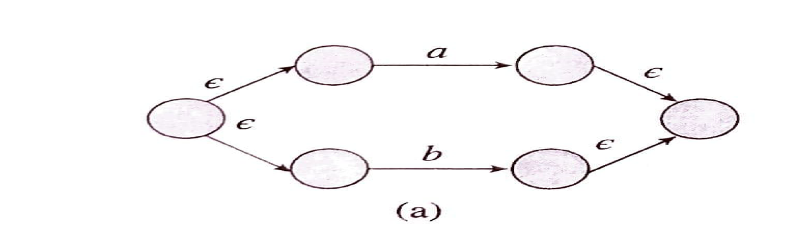
(a) NFA With Epsilon moves for (a+b)

Slide 11
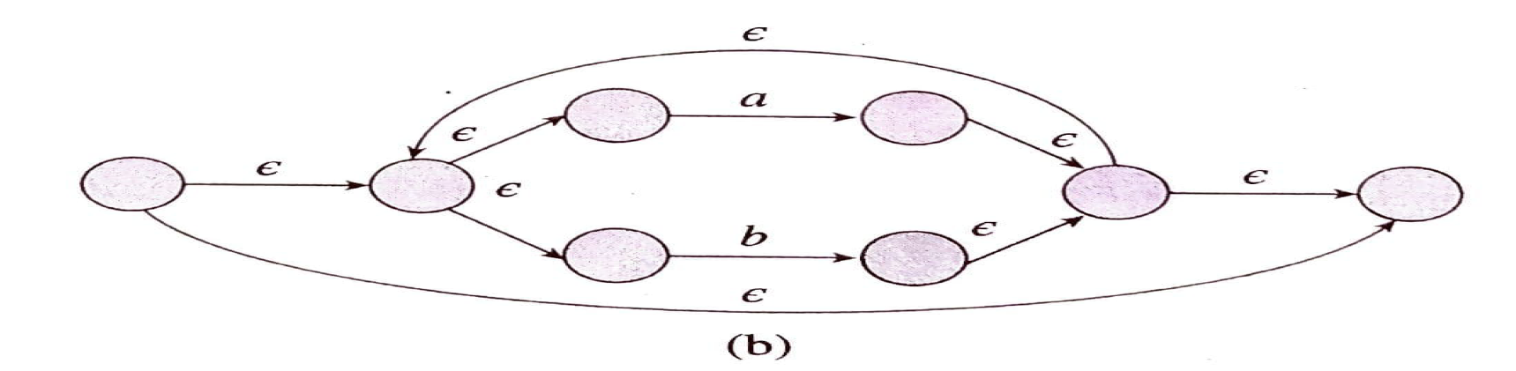
(b) NFA With Epsilon moves for (a+b)*

Slide 12
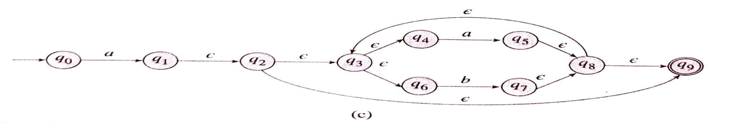
(b) NFA With Epsilon moves for a.(a+b)*

Slide 13
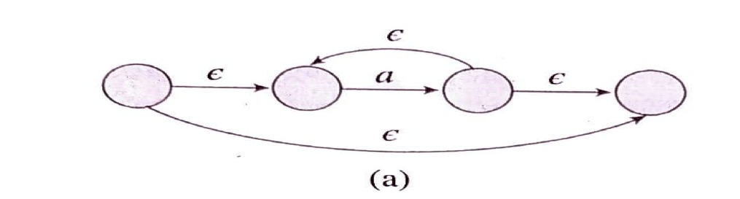
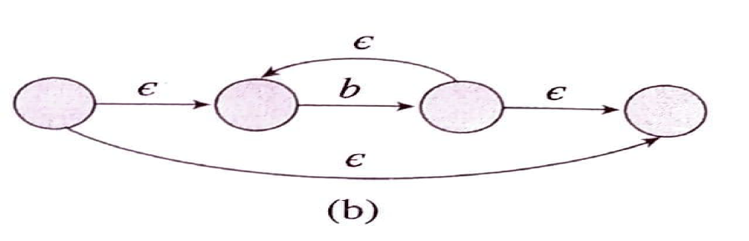
Example 2
(a) Step 1 : a* (b) Step 2: b*

Slide 14
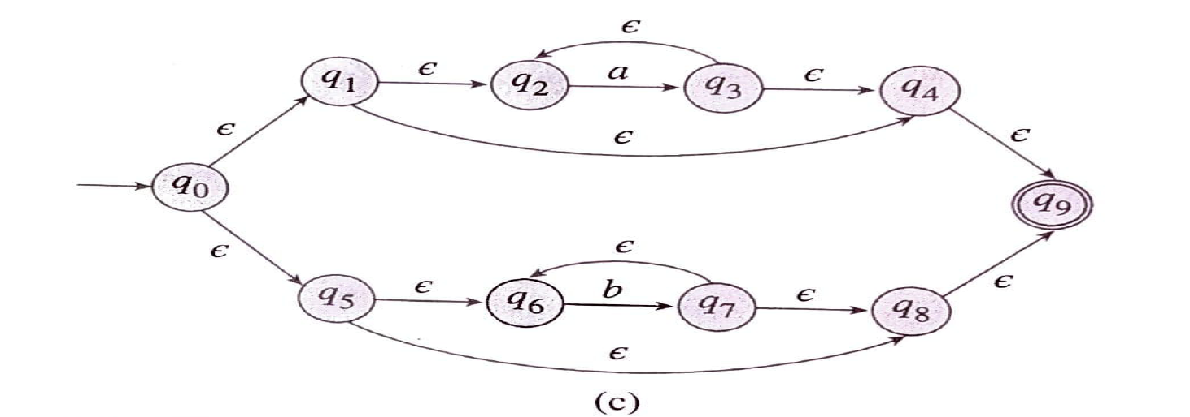
Example 2
(c) Step 3 : (a* + b *)

Slide 15
NFA - ε To DFA Conversion : Direct Method I

Slide 16
Example 1: Design a FA accepting the language represented by RE : r= 0*1*2*

Slide 17
Design a FA accepting the language represented by RE : r= 0*1*2*

Slide 18
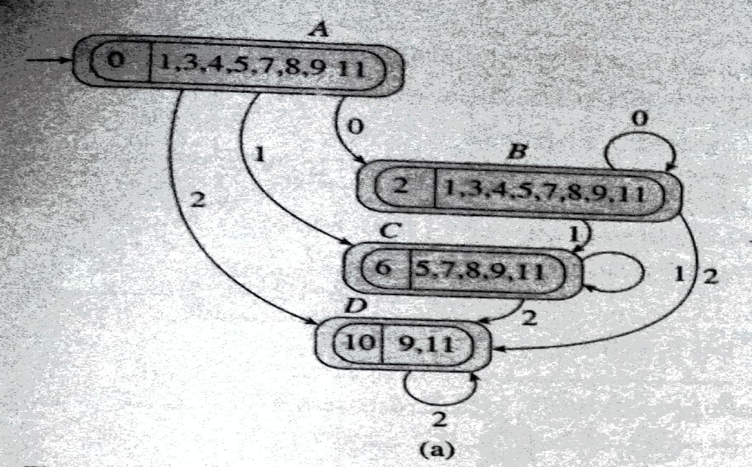
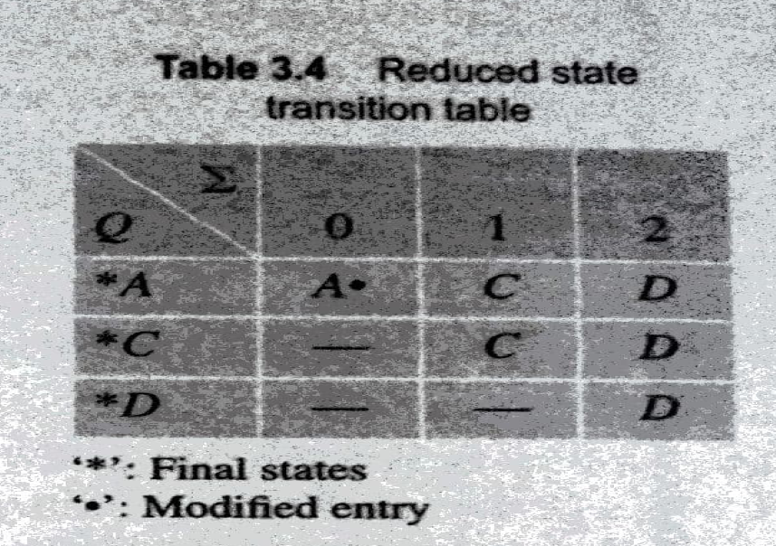
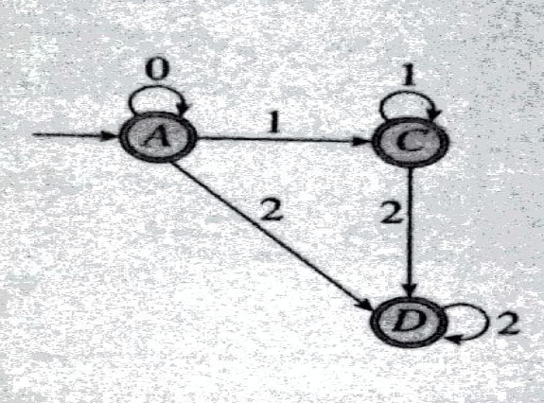
Equivalent DFA

Slide 19
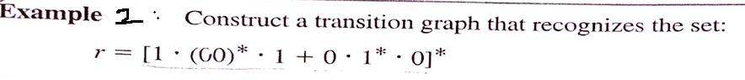
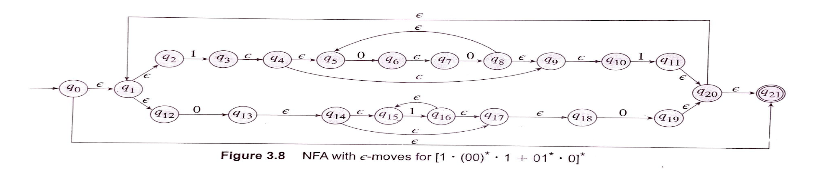

Slide 21
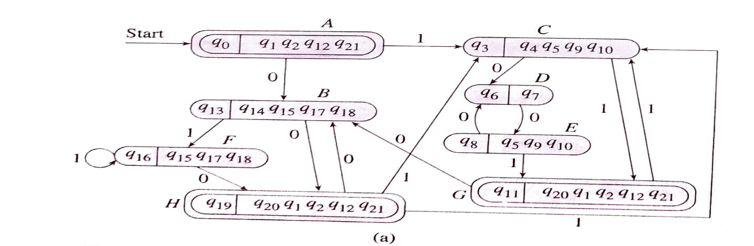
(

Slide 22
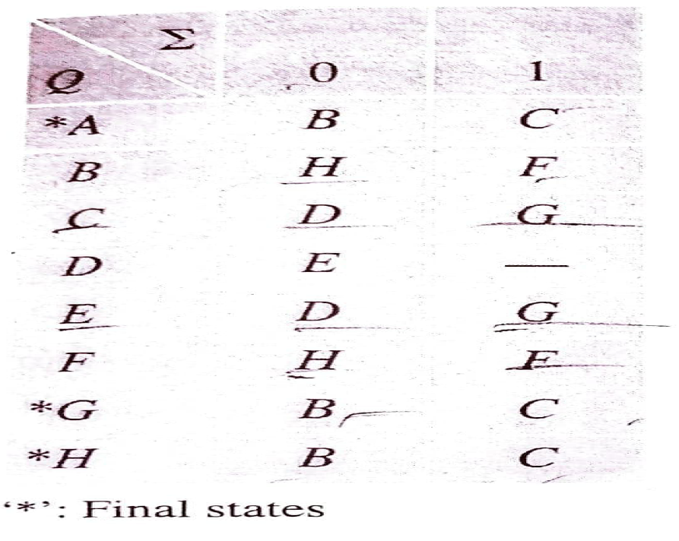
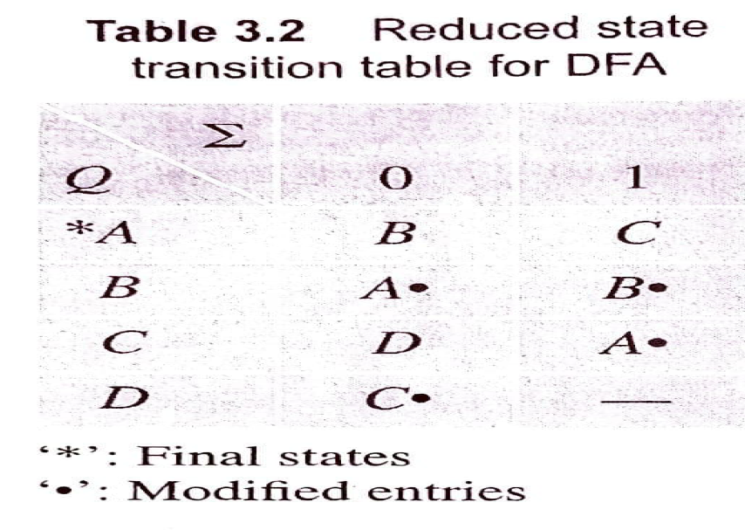
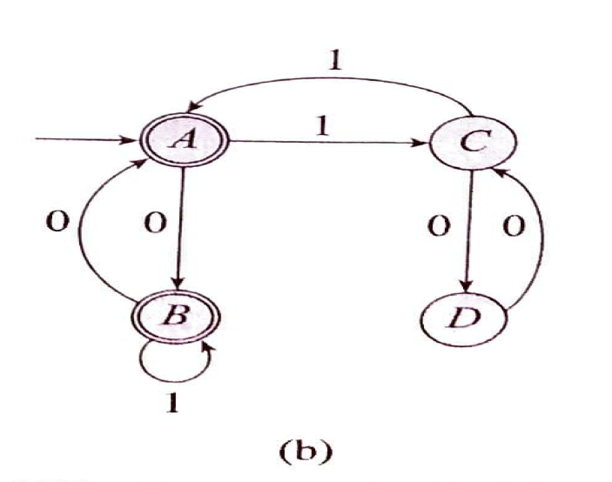
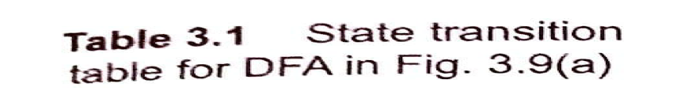

Slide 23

Example 3: Construct DFA that accepts the language represented by following RE

Slide 24
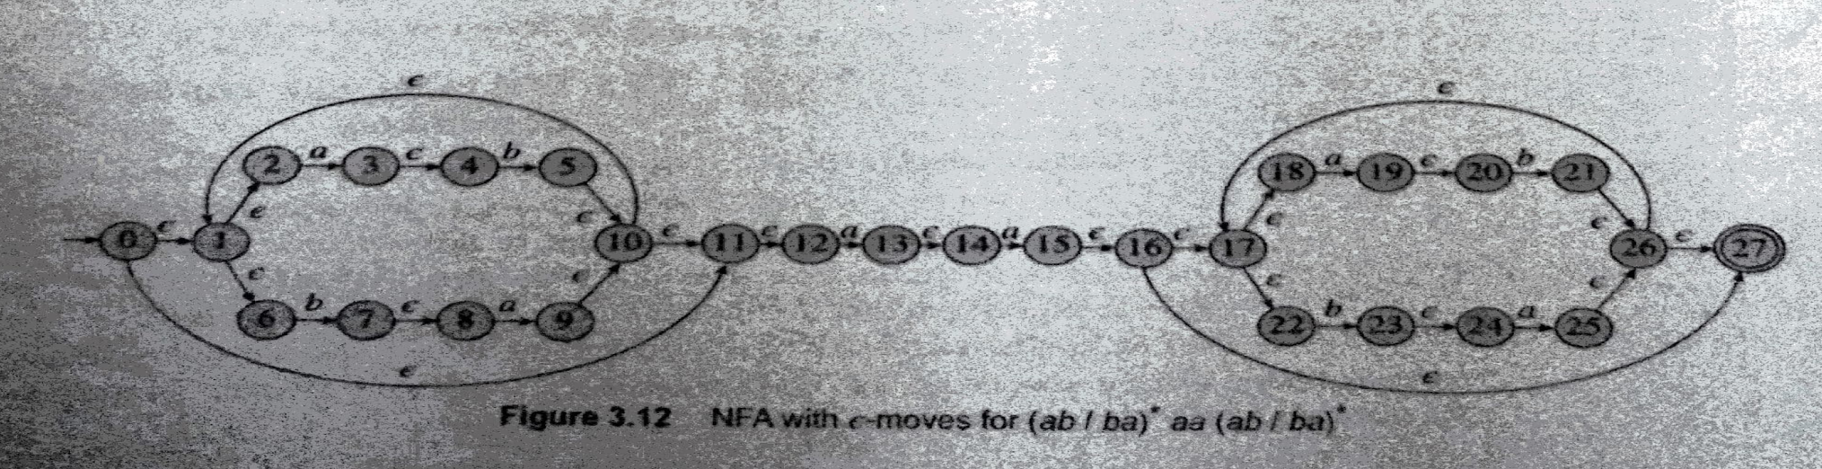

Slide 25
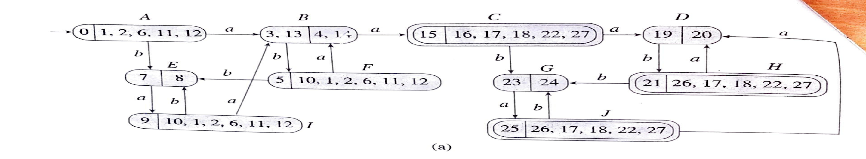

Slide 26
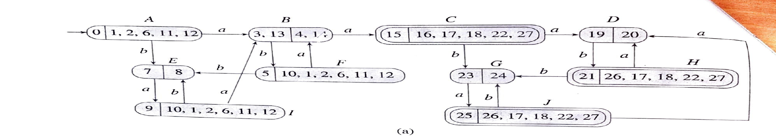
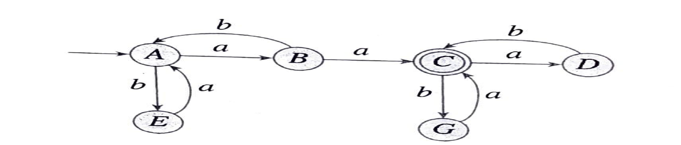

Slide 27
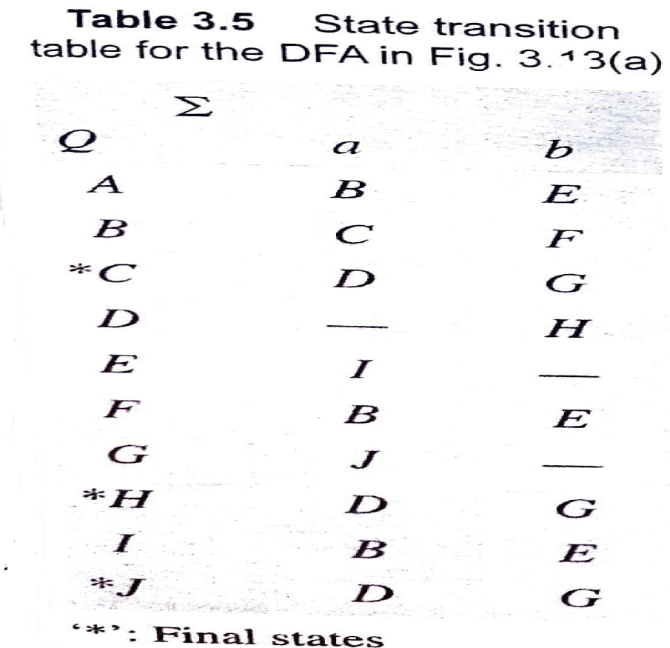
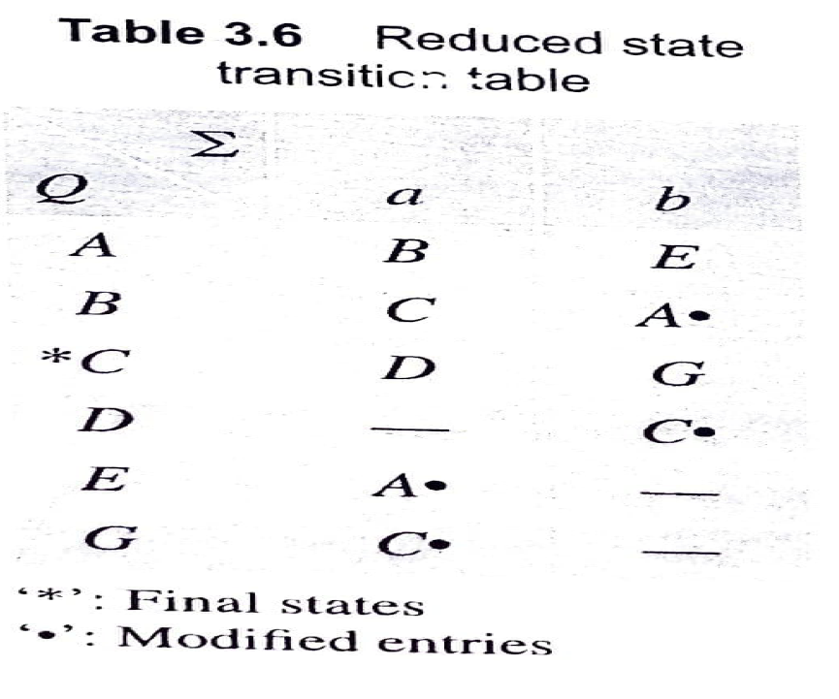

Slide 28
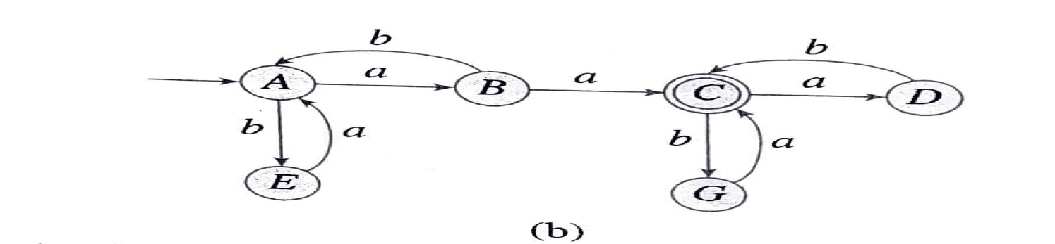
Final DFA

Slide 29
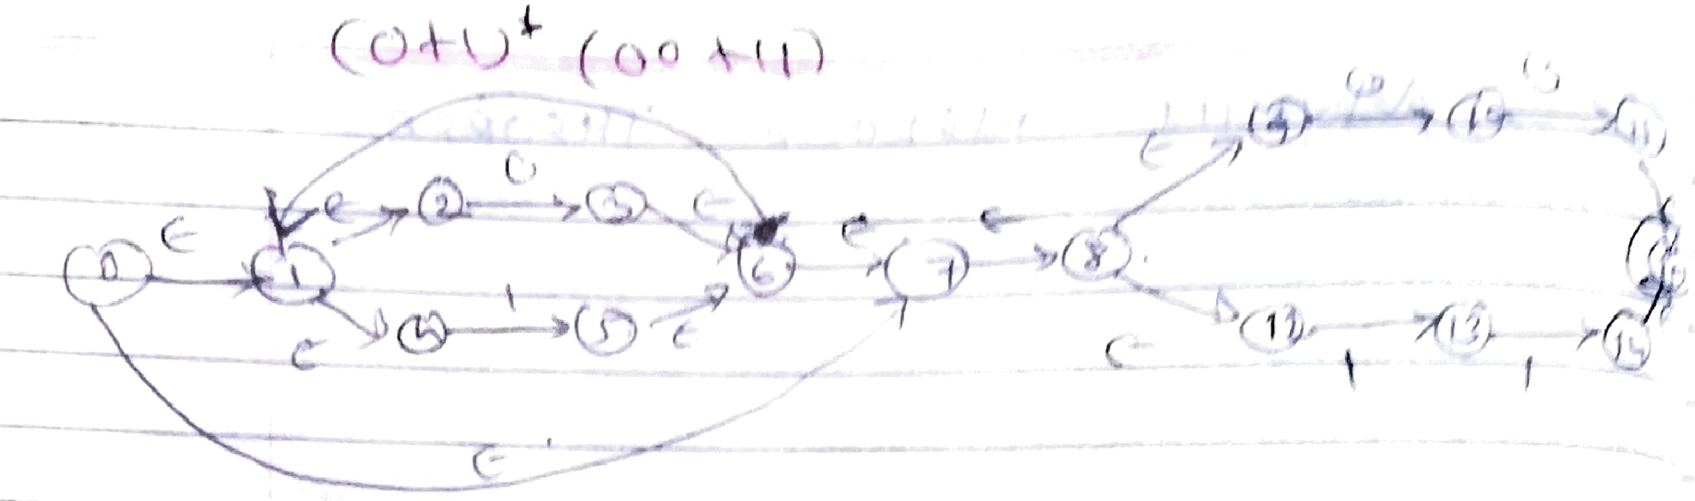
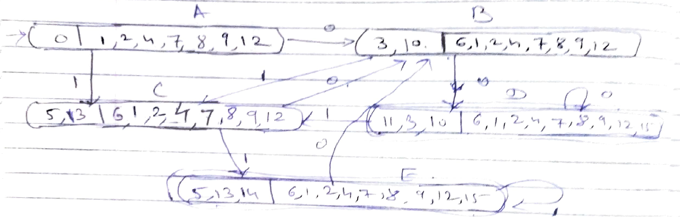
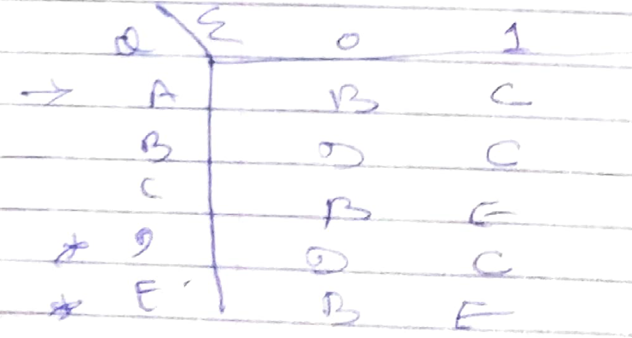
IMP Example 4 : Construct DFA that accepts the language represented by following RE R=(0+1)* (00+11)

Slide 30
NFA with ε to DFA: Direct Method II
Step 1: We will take the ε-closure for the starting state of NFA as a starting state of DFA.
Step 2: Find the states for each input symbol that can be traversed from the present. That means the union of transition value and their closures for each state of NFA present in the current state of DFA.
Step 3: If we found a new state, take it as current state and repeat step 2.
Step 4: Repeat Step 2 and Step 3 until there is no new state present in the transition table of DFA.
Step 5: Mark the states of DFA as a final state which contains the final state of NFA.

Slide 31
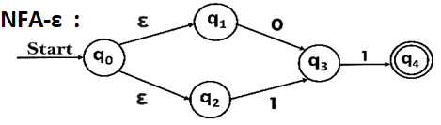
Example 1 Convert the following NFA with ε into its equivalent DFA.
δ_{E} | 0 | 1 | ε
q₀ | Ø | Ø | {q_{1,q2}}
q₁ | {q3} | Ø | Ø
q₂ | Ø | {q3} | Ø
q3 | Ø | {q4} | Ø
*q4 | Ø | Ø | Ø

Slide 32
Example 1
Let us obtain ε-closure of each state.
ε-closure {q0} = {q0, q1, q2}
ε-closure {q1} = {q1}
ε-closure {q2} = {q2}
ε-closure {q3} = {q3}
ε-closure {q4} = {q4}
δ_{E} | 0 | 1 | ε | ε-closure
q₀ | Ø | Ø | {q_{1,q2}} | {q0, q1, q2}
q₁ | {q3} | Ø | Ø | {q1}
q₂ | Ø | {q3} | Ø | {q2}
q3 | Ø | {q4} | Ø | {q3}
*q4 | Ø | Ø | Ø | {q4}

Slide 33
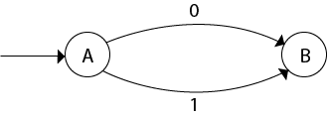
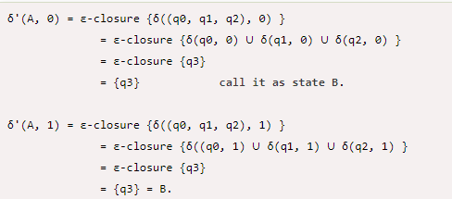
Example 2 Steps for converting NFA with ε to DFA:
Partial DFA will look like this:
Now, let ε-closure {q0} = {q0, q1, q2} be state A.
δ_{E} | 0 | 1 | ε | ε-closure
q₀ | Ø | Ø | {q_{1,q2}} | {q0, q1, q2}
q₁ | {q3} | Ø | Ø | {q1}
q₂ | Ø | {q3} | Ø | {q2}
q3 | Ø | {q4} | Ø | {q3}
*q4 | Ø | Ø | Ø | {q4}

Slide 34
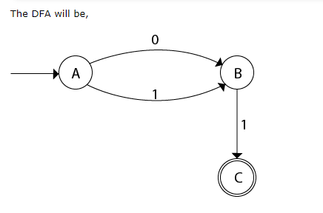
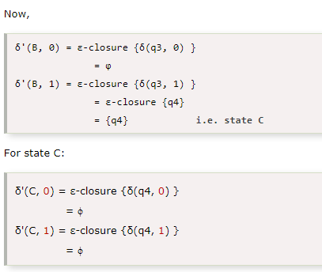
Final DFA
δ_{E} | 0 | 1 | ε | ε-closure
q₀ | Ø | Ø | {q_{1,q2}} | {q0, q1, q2}
q₁ | {q3} | Ø | Ø | {q1}
q₂ | Ø | {q3} | Ø | {q2}
q3 | Ø | {q4} | Ø | {q3}
*q4 | Ø | Ø | Ø | {q4}

Slide 35
EXAMPLE 2

Slide 36
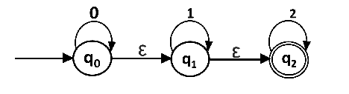
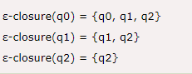
Example 3 Convert the given NFA - ε into its equivalent DFA.
δ_{E} | 0 | 1 | 2 | ε | ε-closure
q₀ | {q0} | Ø | Ø | {q1,q2} | {q0, q1, q2}
q₁ | Ø | {q1} | Ø | {q2} | {q1,q2}
*q₂ | Ø | Ø | {q2} | Ø | {q2}

Slide 37
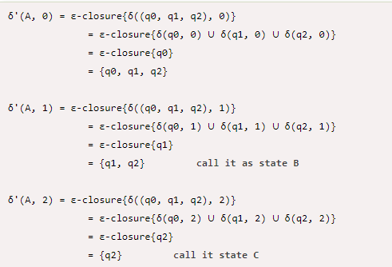
Example 3 Convert the given NFA - ε into its equivalent DFA
Now we will obtain δ' transition. Let ε-closure(q0) = {q0, q1, q2} call it as state A.
δ_{E} | 0 | 1 | 2 | ε | ε-closure
q₀ | {q0} | Ø | Ø | {q1,q2} | {q0, q1, q2}
q₁ | Ø | {q1} | Ø | {q2} | {q1,q2}
*q₂ | Ø | Ø | {q2} | Ø | {q2}

Slide 38
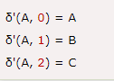
Example 3 Convert the given NFA - ε into its equivalent DFA
Now we will obtain δ' transition. Let ε-closure(q0) = {q0, q1, q2} call it as state A.
δ_{E} | 0 | 1 | 2 | ε | ε-closure
q₀ | {q0} | Ø | Ø | {q1,q2} | {q0, q1, q2}
q₁ | Ø | {q1} | Ø | {q2} | {q1,q2}
*q₂ | Ø | Ø | {q2} | Ø | {q2}

Slide 39
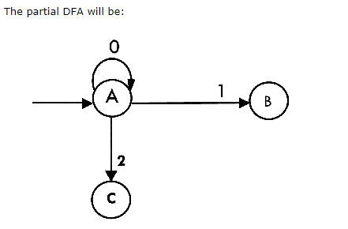
The Partial DFA will be

Slide 40
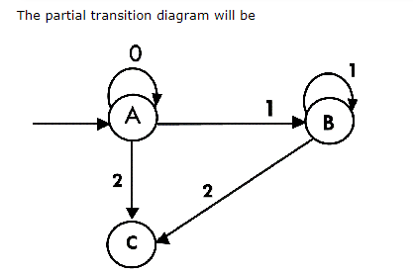
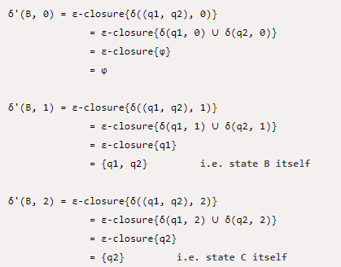
Example 3 Convert the given NFA - ε into its equivalent DFA
State B = {q1,q2}
δ_{E} | 0 | 1 | 2 | ε | ε-closure
q₀ | {q0} | Ø | Ø | {q1,q2} | {q0, q1, q2}
q₁ | Ø | {q1} | Ø | {q2} | {q1,q2}
*q₂ | Ø | Ø | {q2} | Ø | {q2}

Slide 41
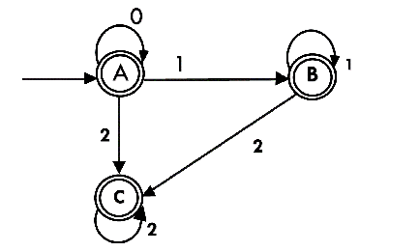
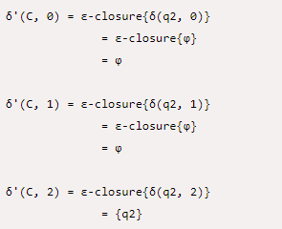
Example 3 Convert the given NFA - ε into its equivalent DFA
δ_{E} | 0 | 1 | 2 | ε | ε-closure
q₀ | {q0} | Ø | Ø | {q1,q2} | {q0, q1, q2}
q₁ | Ø | {q1} | Ø | {q2} | {q1,q2}
*q₂ | Ø | Ø | {q2} | Ø | {q2}
State C = {q2}

Slide 42
Final DFA will be as follows:

Slide 43
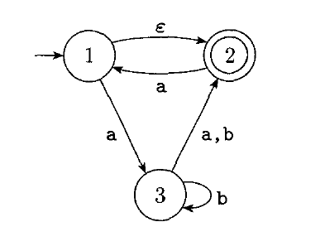
Exercises
Convert NFA with ε transition to equivalent DFA
δ_{E} | a | b | ε | ε-closure
1 | {3} | Ø | {2} | {1,2}
*2 | 1 | Ø | Ø | {2}
3 | 2 | {2,3} | Ø | {3}

Slide 44
Exercises
Convert NFA with ε transition to equivalent DFA
δ_{E} | a | b | ε | ε-closure
1 | {3} | Ø | {2} | {1,2}
*2 | {1} | Ø | Ø | {2}
3 | {2} | {2,3} | Ø | {3}
Let us obtain ε-closure of each state.
ε-closure {1} = {1,2} call this as state A
ε-closure {2} = {2}
ε-closure {3} = {3}
δ'(A, a) = ε-closure {δ(( 1, 2), a) }
= ε-closure { δ(1, a) ∪ δ(2, a) }
= ε-closure {3,1}
= {1,2,3} call it as state B.
δ'(A, b) = ε-closure {δ(( 1, 2), b) }
= ε-closure { δ(1, b) ∪ δ(2, b) }
= ε-closure {Ø}
= Ø
δ'(B, a) = ε-closure {δ(( 1, 2,3), a) }
= ε-closure { δ(1, a) ∪ δ(2, a) ) ∪ δ(3, a) }
= ε-closure {3,1,2}
= {1,2,3}
δ'(B, b) = ε-closure {δ(( 1, 2,3), b) }
= ε-closure { δ(1, b) ∪ δ(2, b) ∪ δ(3, b) }
= ε-closure {2,3}
= {2,3} call it as state C

Slide 45
Exercises
Convert NFA with ε transition to equivalent DFA
δ_{E} | a | b | ε | ε-closure
1 | {3} | Ø | {2} | {1,2}
*2 | {1} | Ø | Ø | {2}
3 | {2} | {2,3} | Ø | {3}
Let us obtain ε-closure of each state.
ε-closure {1} = {1,2} call this as state A
ε-closure {2} = {2}
ε-closure {3} = {3}
δ'(C, a) = ε-closure {δ(( 2, 3), a) }
= ε-closure { δ(2, a) ∪ δ(3, a) }
= ε-closure {3,1}
= {1,2} i.e A
δ'(C, b) = ε-closure {δ(( 2, 3), b) }
= ε-closure { δ(2, b) ∪ δ(3, b) }
= ε-closure {2,3}
= {2,3} ie.C
δ' | a | b
*A | _{B} | Ø
*B | B | C
*C | A | C

Slide 46
Final DFA
δ' | a | b
*A | _{B} | Ø
*B | B | C
*C | A | C
a
A
B
b
a
C
b

Slide 47
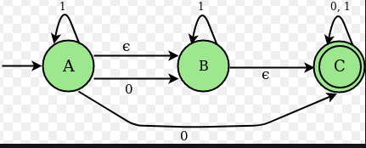
Exercises
Convert NFA with ε transition to equivalent DFA

Slide 48
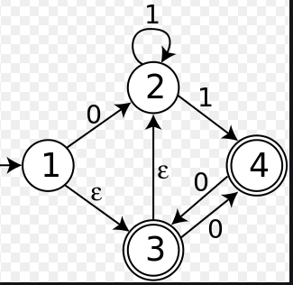
Exercise
Convert NFA with ε transition to equivalent DFA

Slide 49
DFA TO RE (Writing a RE for the given DFA)

Slide 50
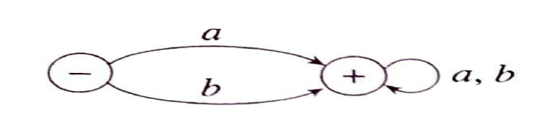
1. Obtain the RE that denotes the language accepted by following FA?
r = (a + b) (a + b) *

Slide 51

2. Obtain the RE that denotes the language accepted by following FA?
r = (a + b) *

Slide 52

3. Obtain the RE that denotes the language accepted by following FA?
r = a.(a + b) *

Slide 53

4. Obtain the RE that denotes the language accepted by following FA?

Slide 54


4. Obtain the RE that denotes the language accepted by following FA?

Slide 55

5. Obtain the RE that denotes the language accepted by following FA?

Slide 56

6. Obtain the RE that denotes the language accepted by following FA?
1
r =

Slide 57
Exercises
L := {w ∈ {a, b}∗ | |w| divisible by 3}
2. L := {w ∈ {a, b}∗ | starts and ends with same character}
3. L := {w ∈ {0, 1}∗ | no of 0 divisible by 3}
L := {w ∈ {0, 1}∗ | starts with 0 and has odd length, or starts with 1 and has even length }
5. All strings which do not contain the substring ba.
((a + b) · (a + b) · (a + b))∗
a (a+b)*a + b(a+b)*)
1* + (1* 0 1* 0 1*01)*
0((0+1) (0+1))* + 1(0+1)((0+1)(0+1))*
a ∗ b ∗

Slide 58
NFA – ε to NFA without ε- moves conversion

Slide 59



Slide 60




Slide 61


Slide 62


Slide 63



Slide 64





Slide 65



Slide 66



Slide 67
1)Design a FA that accepts the language over ∑ = {0,1} containing strings with at least 2 zeroes 2) Design a FA that accepts the language over ∑ = {0,1} containing strings with at the most 2 zeroes 3) Design a FA that accepts the language over ∑ = {0,1} containing strings With exactly two zeroes 4) Design a FA that accepts the language over ∑ = {0,1} containing strings At least 2 consecutive zeroes.

Slide 68
1)Design a FA that accepts the language over ∑ = {0,1} containing strings with at least 2 zeroes

